Slide 1
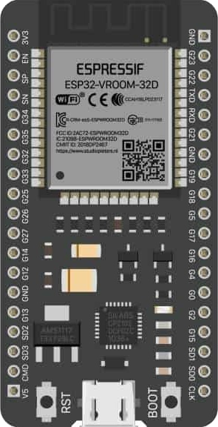
Exmaple 6
ESP32-CAM Live Stream with Mobile DC Motor Control

Slide 2
ESP32 Overview and Programming Guide
Why Use ESP32?
Wireless Connectivity: Built-in Wi-Fi and Bluetooth for IoT.
High Performance: Dual-core processor and low power consumption.
Versatile: Supports digital, analog, PWM, ADC, and DAC pins.
Open Source: Hardware and software are open-source.
Community Support: Extensive tutorials, libraries, and resources.
ESP32 Key Components
Microcontroller: Executes programs.
GPIO Pins: Digital and analog input/output.
Wi-Fi & Bluetooth: For wireless communication.
Power Pins: 3.3V and GND for powering peripherals.

Slide 3
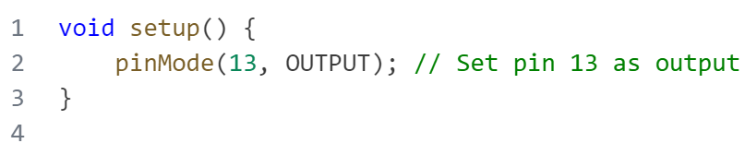
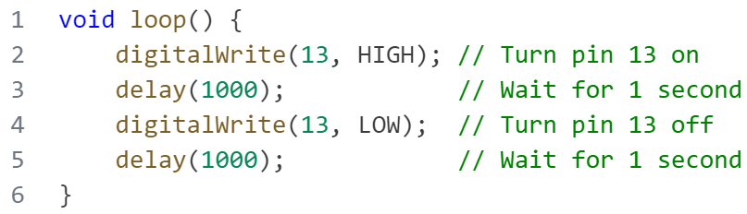
Overview and Programming Guide
Code Structure
code consists of two main functions:
setup()
Runs once at the beginning of the program.
Used to initialize the setup, such as
setting pin modes.
loop()
Runs repeatedly after the setup() function.
Contains the main tasks that the program
will perform.

Slide 4
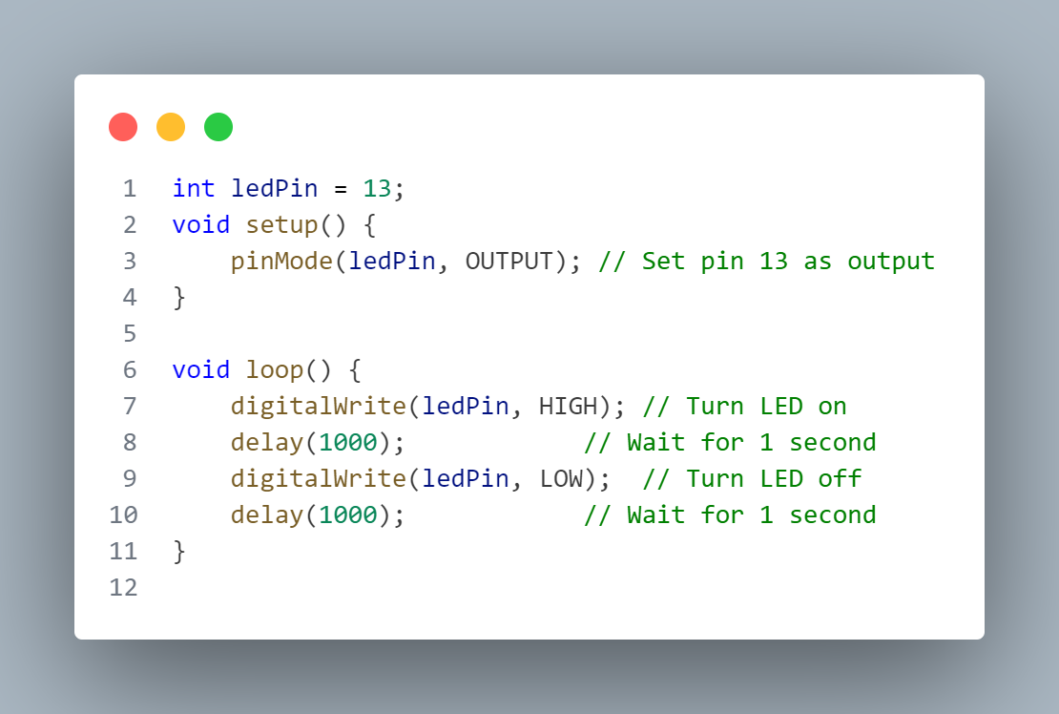
—SOMEONE FAMOUS
Arduino Overview and Programming Guide
Basic Arduino Functions
pinMode(pin, mode): Used to set the pin mode as input (INPUT) or output (OUTPUT).
digitalRead(pin): Reads the state of a digital pin (HIGH or LOW).
digitalWrite(pin, value): Sets the state of a digital pin (HIGH or LOW).
Example 1 - Blinking LED
Objective:
Make an LED blink on and off repeatedly.
Components: Arduino board – LED
Resistor (220 ohms) – Breadboard - Jumper wires.
Steps:
Connect the LED to a digital pin (pin 13)
Connect the other leg of the LED to ground (GND).
Upload the following code to the Arduino.

Slide 5
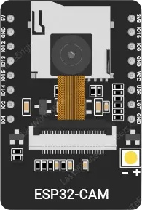
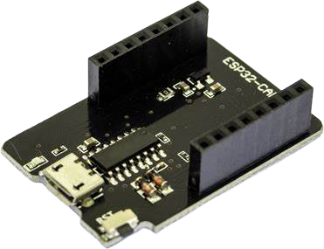
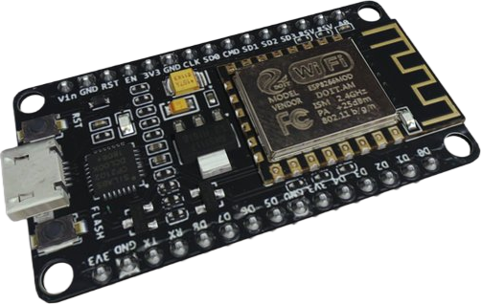
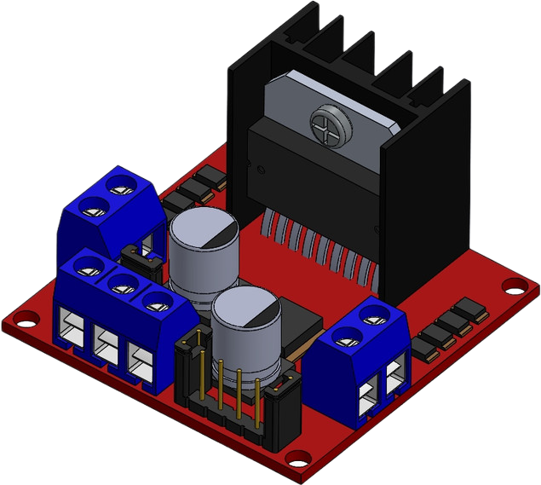
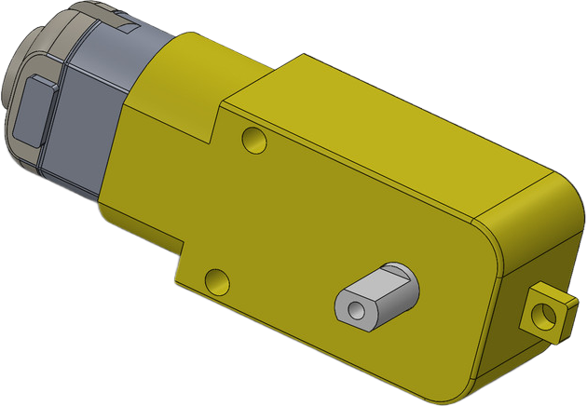
—SOMEONE FAMOUS
Project: DC Motor Control with Motion Sensor Through ESP32
In this project, we will control a DC motor using two ESP32s and a motion sensor, one ESP32 will act as the motion detector (acting as a sensor hub) and the other ESP32 will control the DC motor based on the motion detection signal received via Wi-Fi .
01
ESP32 cam
04
ESP Cam programmer
03
ESP32
02
DC Motor
05
L298N Motor Driver

Slide 6
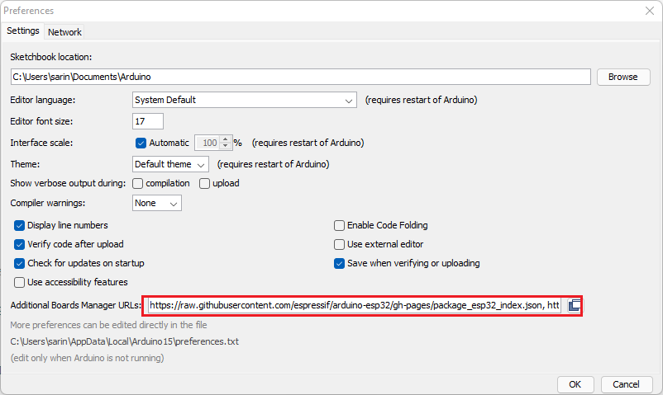
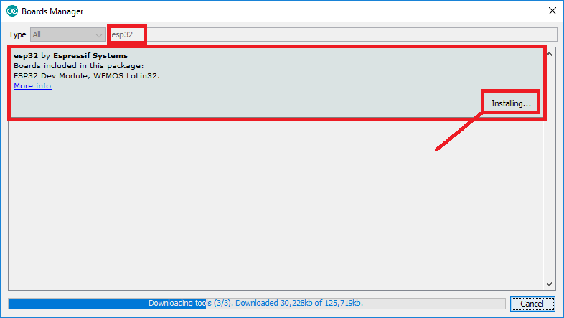
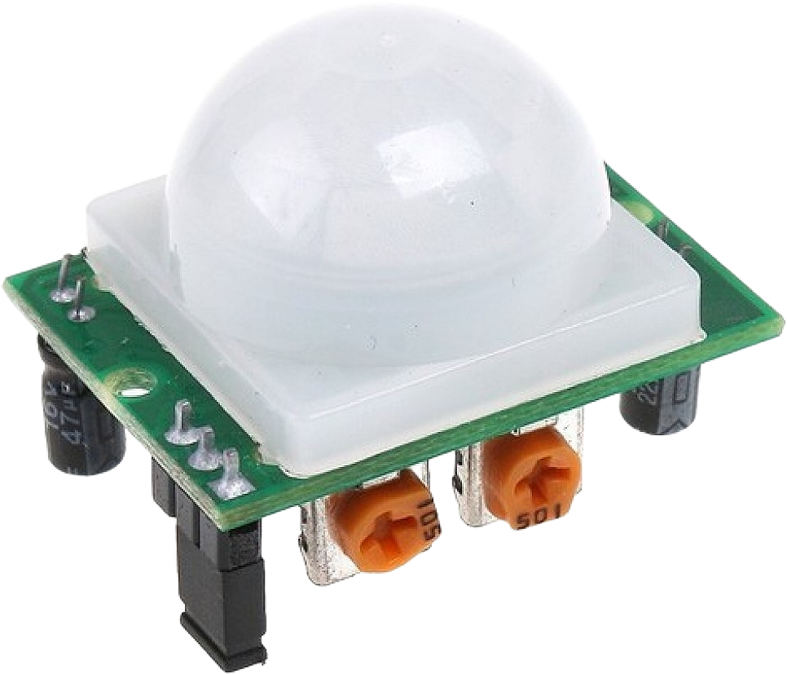
—SOMEONE FAMOUS
Project: DC Motor Control with Motion Sensor Through ESP32
01
ESP32 board
In this project, we will control a DC motor based on the input from a motion sensor (PIR sensor) using an ESP32 board. When motion is detected by the PIR sensor, the DC motor will be activated, and it will stop once the motion is no longer detected.
In your Arduino IDE, go to File> Preferences
Enter the following into the “Additional Board Manager URLs” field:
https://raw.githubusercontent.com/espressif/arduino-esp32/gh-pages/package_esp32_index.json, http://arduino.esp8266.com/stable/package_esp8266com_index.json
Open the Boards Manager. Go to Tools > Board > Boards Manager…
Search for ESP32 and press install button for the “ESP32 by Espressif Systems“
04
L298N Motor Driver
02
DC Motor
05
PIR Motion Sensor

Slide 7
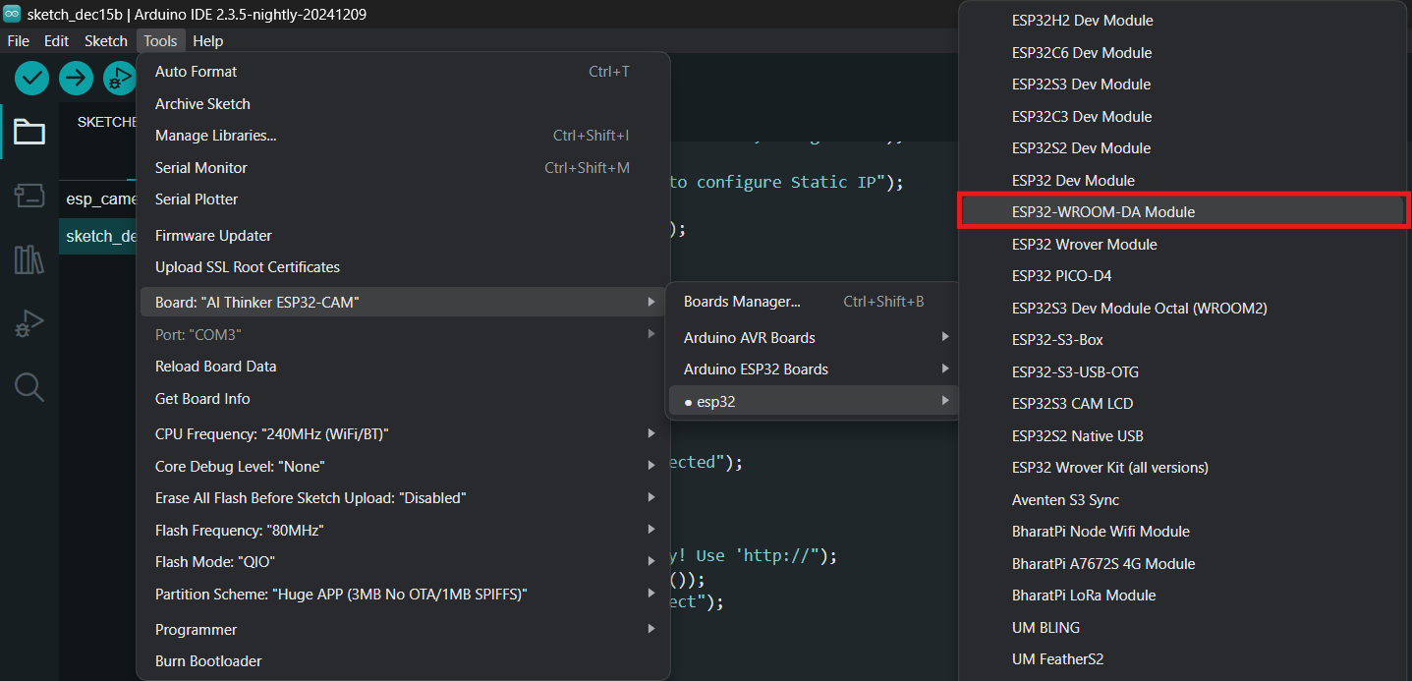
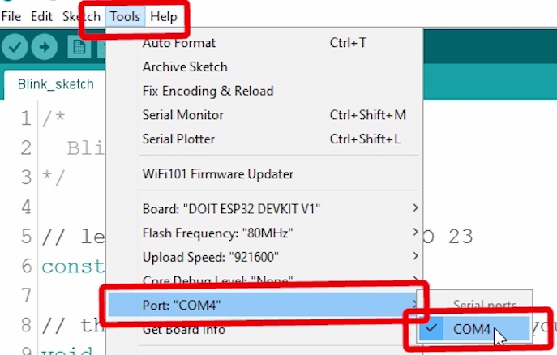
—SOMEONE FAMOUS
Project: DC Motor Control with Motion Sensor Through ESP32
01
ESP32 board
In this project, we will control a DC motor based on the input from a motion sensor (PIR sensor) using an ESP32 board. When motion is detected by the PIR sensor, the DC motor will be activated, and it will stop once the motion is no longer detected.
Select your Board in Tools > Board menu
(in my case it’s the ESP32 WROOM )
Select the Port (if you don’t see the COM Port in your Arduino IDE, you need to install the CP210x USB to UART Bridge VCP Drivers):
04
L298N Motor Driver
02
DC Motor
05
PIR Motion Sensor

Slide 8

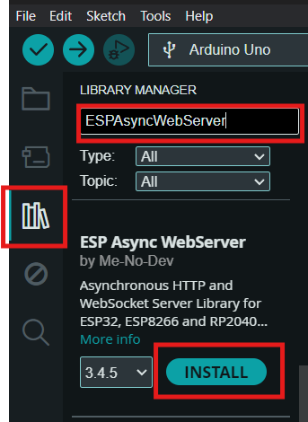
—SOMEONE FAMOUS
Project: DC Motor Control with Motion Sensor Through ESP32
In this project, we will control a DC motor based on the input from a motion sensor (PIR sensor) using an ESP32 board. When motion is detected by the PIR sensor, the DC motor will be activated, and it will stop once the motion is no longer detected.
Select your Board in Tools > Manage library
Search ESPAsyncWebServer
Install ESPAsyncWebServer
04
L298N Motor Driver
02
DC Motor
05
PIR Motion Sensor

Slide 9
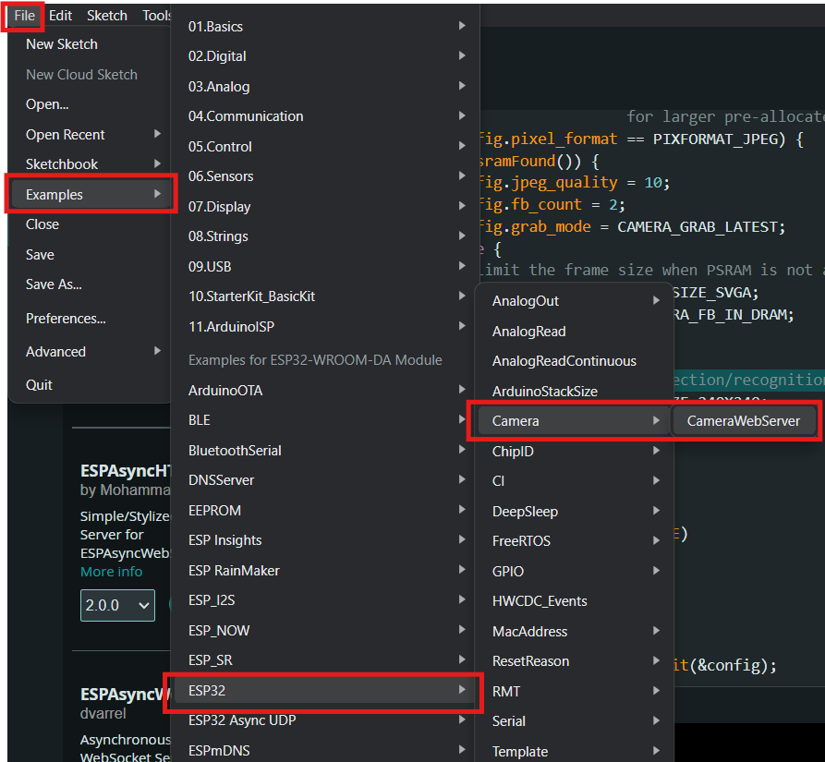
—SOMEONE FAMOUS
Project: DC Motor Control with Motion Sensor Through ESP32
Use ESP cam Example
In this project, we will control a DC motor based on the input from a motion sensor (PIR sensor) using an ESP32 board. When motion is detected by the PIR sensor, the DC motor will be activated, and it will stop once the motion is no longer detected.
04
L298N Motor Driver
02
DC Motor
05
PIR Motion Sensor

Slide 10
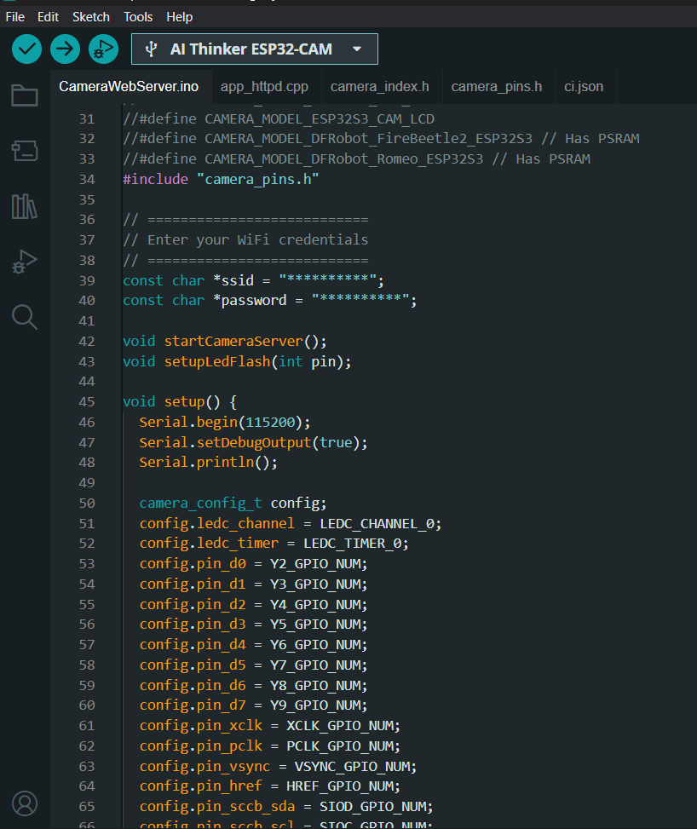
—SOMEONE FAMOUS
01
Project: DC Motor Control with Motion Sensor Through ESP32
ESP32 board
ESP32 Sender
DC Motor
05
PIR Motion Sensor

Slide 11
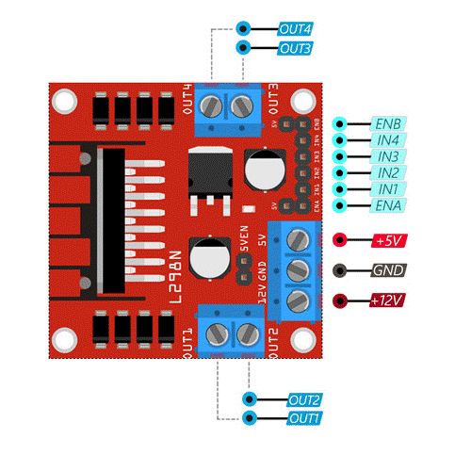
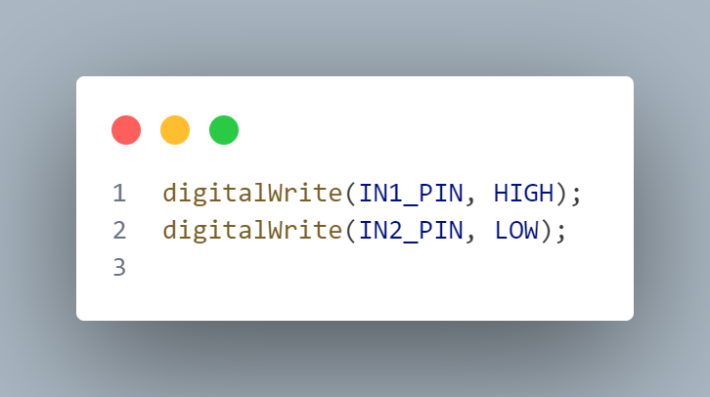

—SOMEONE FAMOUS
01
Project: DC Motor Control with Motion Sensor Through ESP32
ESP32 board
04
L298N Motor Driver
02
In this project, we will control a DC motor based on the input from a motion sensor (PIR sensor) using an ESP32 board. When motion is detected by the PIR sensor, the DC motor will be activated, and it will stop once the motion is no longer detected.
The L298N motor driver is used to control the speed and direction of two DC motors. It operates using an H-bridge circuit and has the following key components:
Power Pins:
VCC: Supplies motor power (5-35V).
GND: Common ground.
5V: Powers the internal logic if motor voltage is below 12V.
Motor A (Channel A):
ENA: Controls speed via PWM.
IN1 & IN2: Control direction:
IN1=HIGH, IN2=LOW: Forward.
IN1=LOW, IN2=HIGH: Reverse.
Both HIGH or LOW: Stop.
OUT1 & OUT2: Connect to Motor A.
Motor B (Channel B):
ENB: Controls speed via PWM.
IN3 & IN4: Control direction:
IN3=HIGH, IN4=LOW: Forward.
IN3=LOW, IN4=HIGH: Reverse.
Both HIGH or LOW: Stop.
OUT3 & OUT4: Connect to Motor B.
DC Motor
05
PIR Motion Sensor

Slide 12
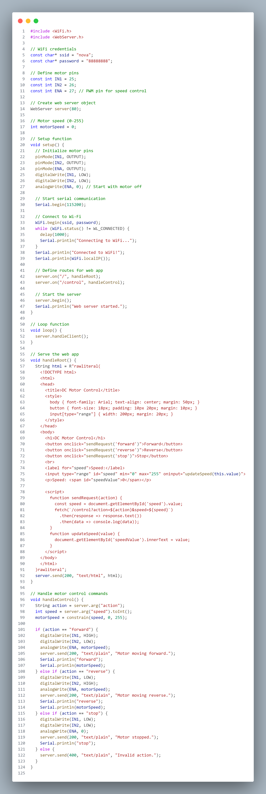
—SOMEONE FAMOUS
01
Project: DC Motor Control with Motion Sensor Through ESP32
ESP32 board
ESP32 Sender
DC Motor
05
PIR Motion Sensor

Slide 13
—SOMEONE FAMOUS
01
Project: DC Motor Control with Motion Sensor Through ESP32
ESP32 board
ESP32 Sender
DC Motor
05
PIR Motion Sensor

Slide 14
—SOMEONE FAMOUS
01
Project: DC Motor Control with Motion Sensor Through ESP32
ESP32 board
ESP32 Sender
DC Motor
05
PIR Motion Sensor

Slide 15
—SOMEONE FAMOUS
01
Project: DC Motor Control with Motion Sensor Through ESP32
ESP32 board
ESP32 Sender
DC Motor
05
PIR Motion Sensor

Slide 16
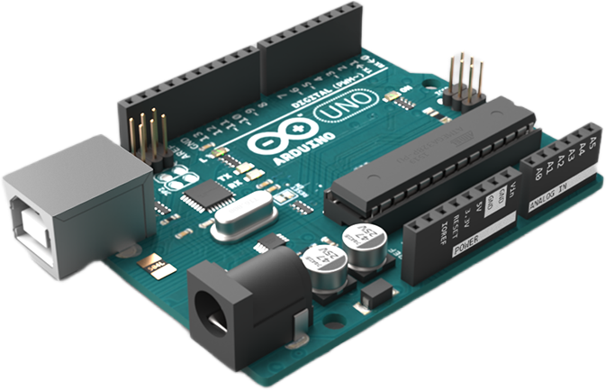
Relational Databases
Thank You
NoSQL Databases
NoSQL (Not Only SQL) databases are
designed to handle unstructured,
semi-structured, and structured
data. They are flexible and scalable,
making them suitable for handling
large volumes of data. Examples
include:
MongoDB (document-oriented)
Cassandra (column-family)
Redis (key-value)
Elasticsearch (search-oriented)
Relational databases store data in
structured tables with rows and
columns. They use SQL (Structured
Query Language) for querying and
managing data. Examples include:
MySQL
PostgreSQL
SQLite
Microsoft SQL Server
Oracle Database

